Slide 1


Testing Effort Estimation
Nhan Nguyen

Slide 2

How many piece?

Slide 3
How many piece? - Answer
- 193 piece.
- plus 1 candy in side.

Slide 4

Outline
Course Objectives
Define of test Estimation
Some estimation methods
Some tips to estimate
Example
Q&A

Slide 5
Objective
Understand some estimate methods which can apply in the testing estimate.
Share some tips in the estimation.
Example

Slide 6
Definition of Test Estimation
Test estimation is the estimation of:
Testing size
Testing effort
Testing cost
Testing schedule
For a specified software testing project in a specified environment using defined methods, tools and techniques.
Notes:
can’t use the same estimate for different project.
1. Testing Size – the amount of testing that needs to be carried out
2. Testing effort – the amount of effort in either person days or person hours
3. Testing cost – the expenses necessary for testing, including the cost of human effort
4. Testing Schedule – the duration in calendar days or months that is necessary for conducting the tests

Slide 7
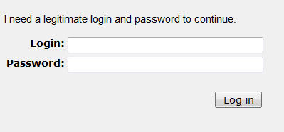
How long to test a login form?
Testing Effort or Testing schedule?
Notes:
- Ask people to estimate the time to test the login form.
- why are there different number?
- Don’t answer which number is right

Slide 8
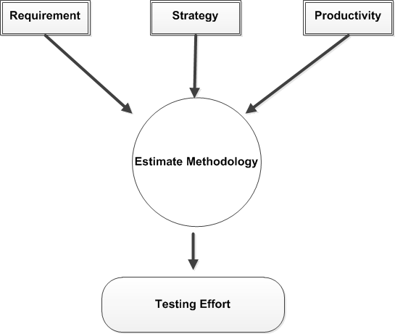
Strategy based effort estimate
Assumption
Notes:
Requirement: requirement to test, input information.
Strategy: is to find the most important defects as early as possible at a lowest cost. What, When, Why, How to test?
Productivity of the team. Estimate for AQC, QC, PQC,..

Slide 9
Estimate methodology
Best guess methodology
Experience-based methodology
Breakdown Structure
3-Point Software Testing Estimation
Test case enumeration based estimation
Percentage distribution

Slide 10
Best Guess methodology
- Guess work
- Base on the experience

Slide 11
Experience-based methodology
Metrics collected from previous tests.
You already tested similar application in previous project.
Inputs are taken from Subject Matter experts who know the application (as well as testing) very well

Slide 12
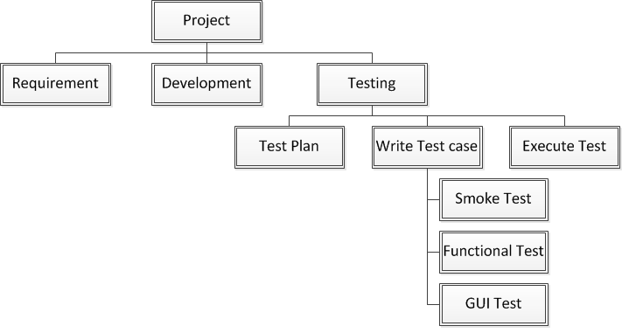
Work-breakdown Structure
Notes:
- The estimation of the project is sum up of the piece of tasks.
- Break to small of work and estimate for each of them.

Slide 13
Three Point Software Testing
Based on statistical methods in which each testing task is broken down into sub tasks and then apply three types on estimation are done on each tasks:
Best Estimate = B
Normal Estimate = N
Worse Estimate = W
=> Estimate = (B +(4*N)+ W)/6
Notes:
Best estimate: all things are going well. There is no defect.
Normal estimate: assumption that there are 20% cases will be failed.
Worse Estimate: assumption that there are 50% cases will be failed.

Slide 14
Test case enumeration based
List all test cases
Estimate the testing effort required for each test case
Sum up

Slide 15
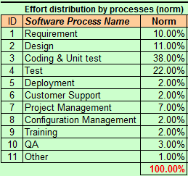
Percentage distribution
UCP or WBS estimate for coding & unit test
=> other tasks are based on the percentage.
Notes:
It is current norm in HvN.

Slide 16
Some tips to estimate
Think of Some Buffer Time
Consider the Bug Cycle
Estimations Can Go Wrong – So re-visit the estimations frequently in initial stages before you commit it.
Think of Your Past Experience to Make Judgments!
Consider the Scope of Project
Are You Going to Perform Load Testing?
Do You Know Your Team?
Domain Knowledge
Notes:
1) Think of Some Buffer Time The estimation should include some buffer. But do not add a buffer, which is not realistic. Having a buffer in the estimation enables to cope for any delays that may occur. Having a buffer also helps to ensure maximum test coverage.
2) Consider the Bug Cycle The test estimation also includes the bug cycle. The actual test cycle may take more days than estimated. To avoid this, we should consider the fact that test cycle depends on the stability of the build. If the build is not stable, then developers may need more time to fix and obviously the testing cycle gets extended automatically.
3) Estimations Can Go Wrong – So re-visit the estimations frequently in initial stages before you commit it. In early stages, we should frequently re-visit the test estimations and make modification if needed. We should not extend the estimation once we freeze it, unless there are major changes in requirement.
4) Think of Your Past Experience to Make Judgments! Experiences from past projects play a vital role while preparing the time estimates. We can try to avoid all the difficulties or issues that were faced in past projects. We can analyze how the previous estimates were and how much they helped to deliver product on time.
5) Consider the Scope of Project Know what is the end objective of the project and list of all final deliverables. Factors to be considered for small and large projects differ a lot. Large project, typically include setting up test bed, generating test data, test scripts etc. Hence the estimations should be based on all these factors. Whereas in small projects, typically the test cycle include test cases writing, execution and regression.
6 ) Are You Going to Perform Load Testing? If you need to put considerable time on performance testing then estimate accordingly. Estimations for projects, which involve load testing, should be considered differently.
7) Do You Know Your Team? If you know strengths and weaknesses of individuals working in your team then you can estimate testing tasks more precisely. While estimating one should consider the fact that all resources may not yield same productivity level. Some people can execute faster compared to others. Though this is not a major factor but it adds up to the total delay in deliverables. The estimate is for which level.

Slide 17
Example 1
Requirement:
- Do functional testing similar to amazon.com
- System has 200 functions:
+ mostly add/edit/list pages.
+ the number of fields are not the same.
- Duration to estimate: 1 day.
Question:
- How long to test this system?
Notes:
- Consider on Risk: => adjust the criteria of the complexity level, estimate for each level.
Simple level has many functions. High risk
- Estimate for 1 round.

Slide 18
Example 1 (cont.)
Assumption:
Use WBS to estimate the testing effort.
There is no workflow after submitting a form.
Test in 1 round.
Complexity level | Estimate for each level (man-hours) | Total functions | Notes
Simple | 1 | 130 | contains no more than five fields
Normal | 2 | 40 | contains between six and eleven fields
Complex | 4 | 30 | contains more than eleven fields

Slide 19
Example 2
Requirement:
- As a user I want to login to the system by entering Login name and password.
Question:
- How long to test the login form?

Slide 20
Example 2 – Cont.
Assumption:
- Write a checklist to test the login form.
- There is no special rule.
- Functional test only.
- Test in 1 browser. (FireFox 12.0)
- Estimate is not including the setup environment.
Strategy:
- Positive/Negative cases with boundary testing technique only.
Estimate: 5 minutes

Slide 21
What is a Best Estimate Method?
Depended on the requirement, accepted risks and situation.
Make assumption.
Define the strategy to test.
Combination of all methodologies (if possible)
Use two methodologies for double check the result.
WBS & 3 point estimate.
Assumption

Slide 22
Q&A
….Thanks

